Slide 1
Inha University in Tashkent
Theme 2: Eastern and Western Philosophy in Ancient and Classical Periods

Slide 2
Outline:
The Role of Mythology in the Formation of Philosophical Thoughts
Eastern Philosophy
Egyptian and Babylonian Philosophy
Indian Philosophical Thoughts
Chinese Philosophy
Greek Philosophy in Classical Period

Slide 3
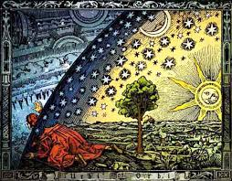
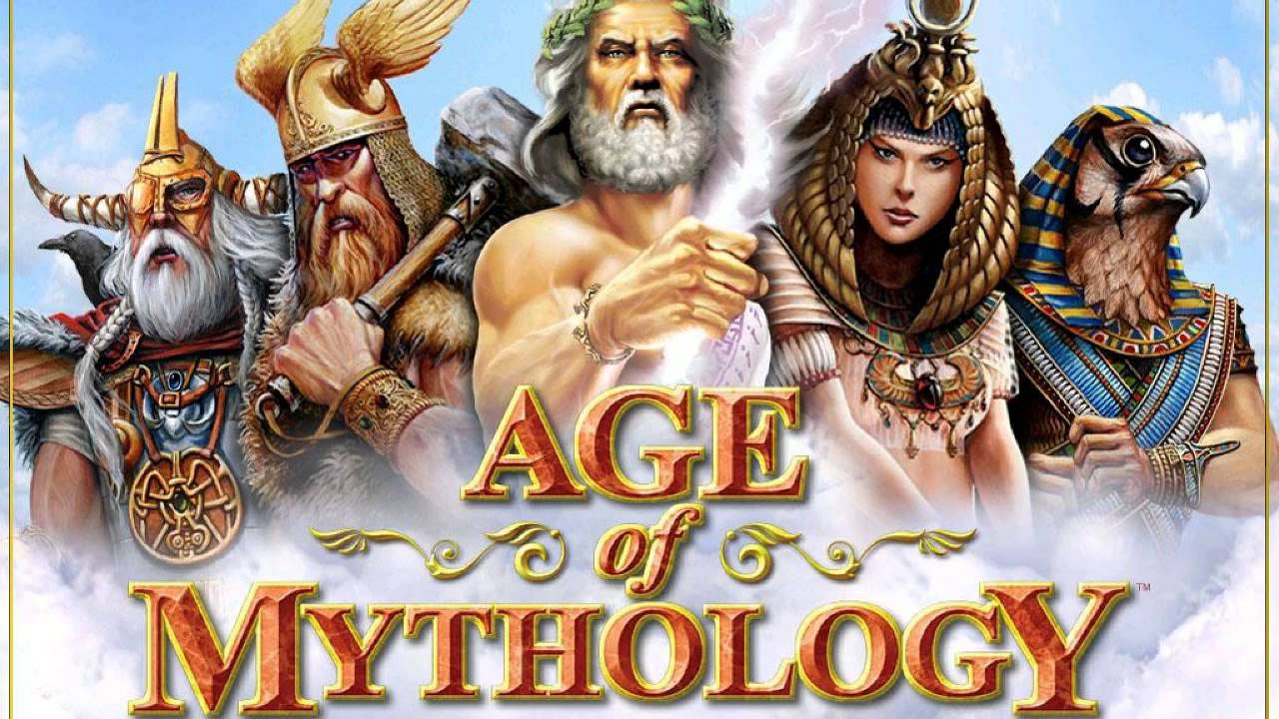
Formation of Philosophical Thoughts
Philosophical thought, firstly, in the East and in the West, was originated from mythology as the first form of social consciousness.
The term mythology is derived from Middle French and it means "exposition of myths". The term appeared in the 15th century.
Mythology explains the world and all phenomena in it by the action of gods and heroes.
A number of religious-philosophical questions were posed in mythology for the first time in the history of mankind: how did the world come into being and how does it develop; what is existence and death?, and others.

Slide 4
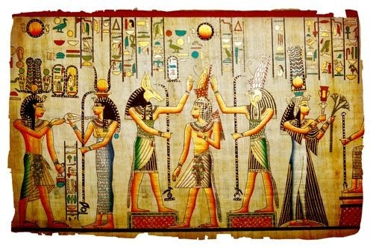
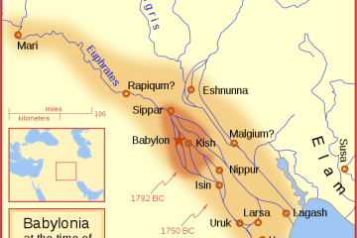
Egyptian and Babylonian Philosophy
Some of the earliest religious-philosophical ideas developed in the historical territories of modern Egypt and Iraq.
Babylon was originally a small city dating from the period of the Akkadian Empire c. 2300 BC. The town became an independent city-state in the 19th century BC.
religio-philosophical thoughts were well reflected in the works – “The Dialogue between Master and his Slave on the Essence of Life”, “The song of Arfist”

Slide 5
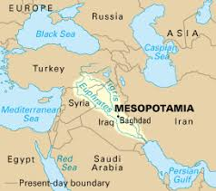
The characteristic feature of philosophy of ancient Egypt and Babylon was, on the one hand, belief in gods, the influence of divine powers on nature and society.
But on the other hand, the religious views resulted in the formation of secular knowledge and scientific thoughts. It should be noted that this feature is distinctive for all the civilizations in ancient times.

Slide 6
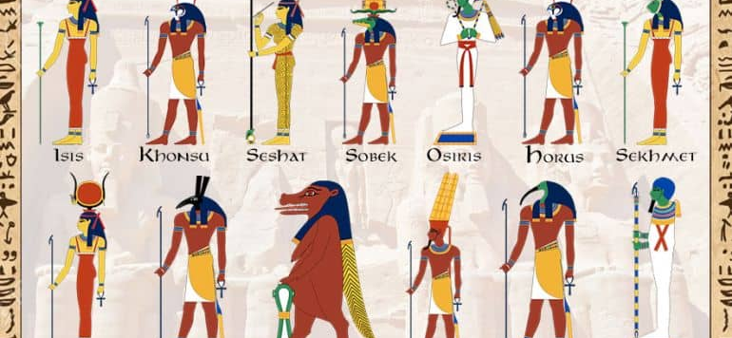
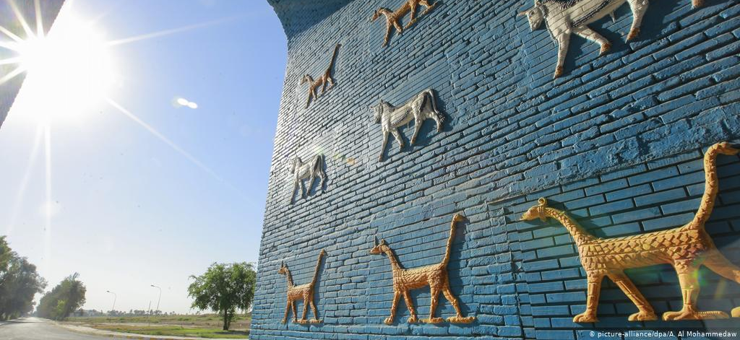
Features of Ancient Period
Polytheism
Believe in magic
Divinity of ruler

Slide 7
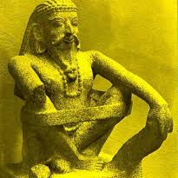
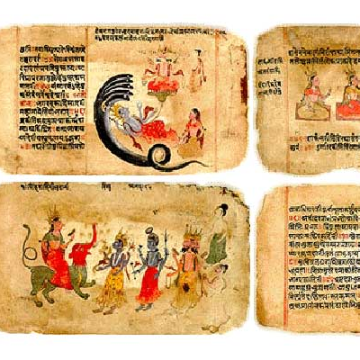
Indian Philosophy
Ancient India is also one of the cradles of human civilization. The original doctrines of Indian ancient philosophy are demonstrated in the written sources such as the Vedas.
The Vedas are sacred texts, written in circa 1,500 BC, a religious science and prophetic book. The Hindus regard Vedas as the words spoken by the Supreme Lord – Brahma. The Vedas contain ancient Hindu history, economy, religion, philosophy, morality. The Vedas have come to us in the form of four collections (samhites). These are "Rigveda", "Samaveda", "Yajurveda", "Adharvaveda".

Slide 8
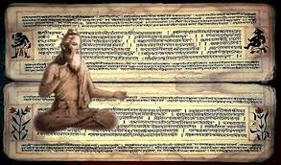
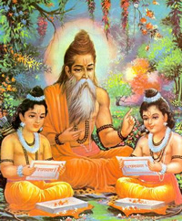
Upanishads
The basis of Indian philosophy is also met in "Upanishads".
The "Upanishads" are the philosophical part of Vedas that mean mysterious knowledge.
"Upanishads" are neither books nor philosophical booklets, but they were composed of texts at different times by some authors.
The philosophical issues of "Upanishads" primarily are the universe surrounding the person, its place and the role in life, outside world and human nature, the essence of life and mentality, standards of morals.

Slide 9
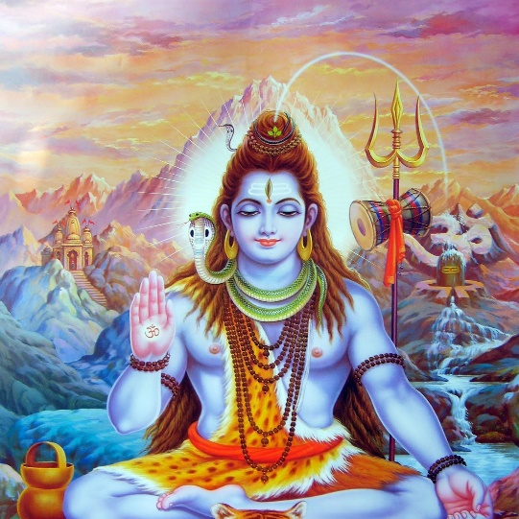
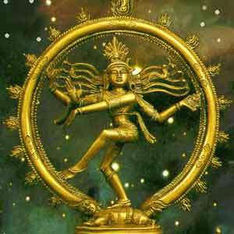
Indian philosophical schools
Ancient Indian philosophical schools were divided into two groups. Hindu philosophers defined these groups astika and nastika.
Philosophical schools – Vedanta, yoga, vaysheshika, and mimansa – belong to astika group. Members of these schools acknowledged the holiness of the "Vedas" and assert that the only truth was expressed in it.
Nastika group includes Charvaka Lokayata, Buddhism and Jainism. Charvaka-lokayata supporters followed materialist teachings. They do not admit the holiness of the "Vedas" as Buddhism and Jainism.

Slide 10
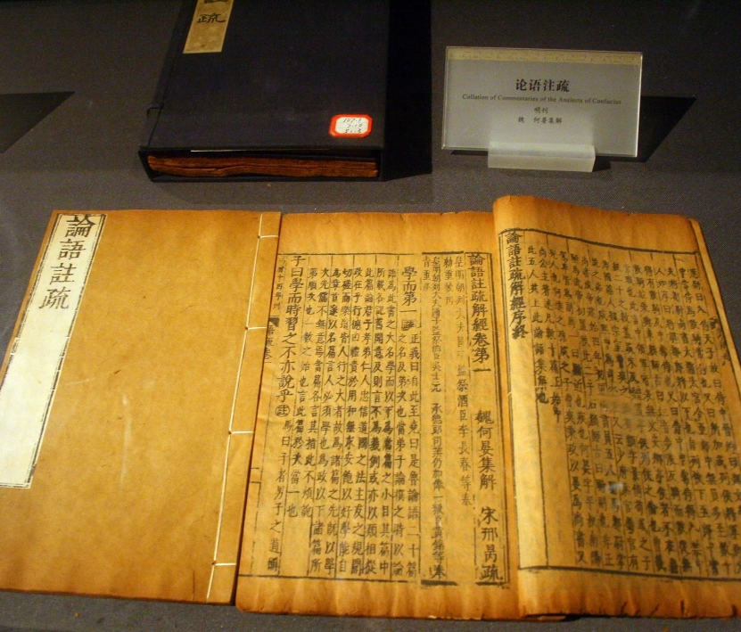
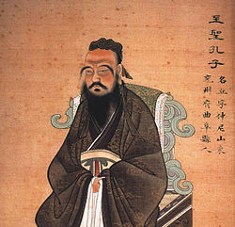
Chinese Philosophy
In ancient China, science and culture have developed in a specific way. One of major Chinese philosophical branches is Confucianism. The founder of the school was Confucius – Kong Fuzi. He was a Chinese teacher, editor, politician, and philosopher.
According to Confucius (551-479), the universe is ruled by the heaven. The will of heaven is destiny. The world we live in, the order in it, was sent by the ruler of heaven. According to Confucius's view, the essence of the order defines the concept of "Li". It reflects the essence of the order of the world.

Slide 11


Daoism
One of the foremost philosopher of ancient China was Lao-Tzu (VI-V centuries). According to his teachings, the nature, society, and human life must obey the Dao's law. According to this law, "Tsi" – five elements - fire, water, air, land and wood or metal constitute the basis of the objects of the world and ensure their occurrence. Lao-Tzu says that nothing in the universe can be permanent and stable, immobilized.
According to Daoism, everything in the world is moving from one state to the other. The struggle between the opposing forces, that is, the relationship between In and Yan is the source of the forces that move the universe that surrounds us. It is a struggle between In and Yan. Human beings must always be on the side of good in the struggle, to love the surrounding nature and the world around them. Otherwise, the Dao's law will be broken and eventually there will be trouble, tragedy.

Slide 12
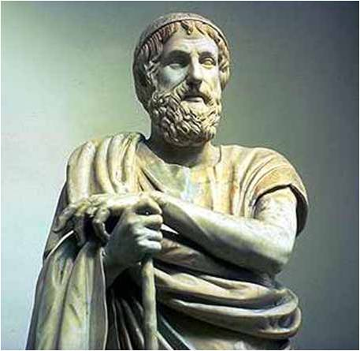

Ancient Greek Philosophy
Ancient Greek Philosophy in terms of historical period covers the sixth century BC – the third century AD. It includes Pre-Socratic, Classical Greek and Hellenistic periods.
The philosophers of Pre-Socratic period first posed the question on the first principle of the universe.
According to Thales of Miletus (624-546 BC) the universe is based on “all the water”.
His disciple – Anaximander believed that the world as infinite, gaseous apeiron, heat and cold, it promotes the transformation of matter from one state to another. He wrote about "Nature", but the work did not reach us.
Anaximenes (588-525 BC) stated that the air was the foundation of the universe.

Slide 13


Heraclitus
Another Greek philosopher Heraclitus (520-460 BC) was born in a jewelry family in Ephesus on the military shore of Asia Minor.
He founded the cognitive dialectics and regarded the fire as the foundation of the universe. In his view, everything is moving in the universe. There is no stagnation in the universe. The movement belongs to the whole nature, to all objects and phenomena. Eternal action is eternal change. The movement takes place in striking contrast.
According to Heraclitus, the constant change, movement and transition to the opposite sides are related to the relative quality of objects. For example, if the seawater is unsuitable for human consumption, it is suitable for fish. Heraclitus's views have had a great impact on the development of philosophical thinking.

Slide 14
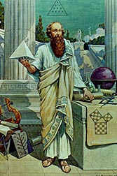
Pythagoras
Pythagoras (580-500 BC) lived in the Greek island of Samos. He founded the religious-ideological philosophical school in ancient Greece.
According to him, the process of learning the world must first begin with knowing the numbers. According to the teachings of the Pythagoras, on the basis of the universe lies not the matter, nor the nature, but the idealized figures, that is; numbers. Things and events are the result of these numbers.
Pythagoras first proposed a quantitative category in explaining things and phenomena in nature.
Pythagoras belonged to the tribe of nobles and defended aristocracy. He said that the order of aristocratic rule was of vital importance in social life. In his view, democracy is a violation of this order.

Slide 15
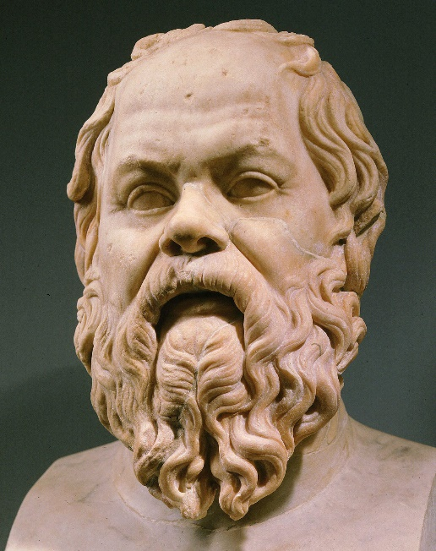

Socrates
Socrates made a radical revolution in philosophy. Realizing that natural philosophy is largely indifferent to man, Socrates reinterprets the basic philosophical questioning. Not physics, but ethics was put by Socrates in first place. It is the philosophy of man that must become the key to the philosophy of nature, and not vice versa.
In this connection, Socrates attaches paramount importance to the fact that man is a knowing and intelligent being. The essence of man is the soul. The soul differs from other beings. The soul is a person's ability to realize, manifest mental activity, be conscientious and moral, virtuous.
The potential of the soul is realized in knowledge, the lack of the latter is ignorance. The human body does not dominate his soul, on the contrary, it is an instrument of the soul.

Slide 16
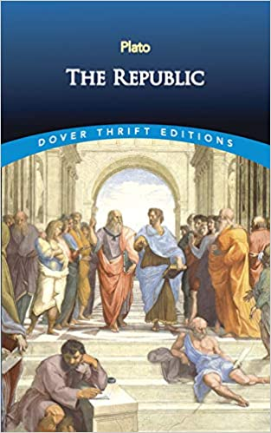
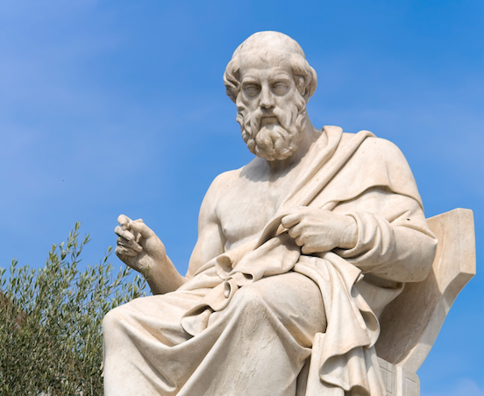
Plato
Plato is a great ally in the history of the world philosophy. He is not only a philosopher, but also an artist, a poet and playwright, and he expressed his ideas in the form of dialogues. Aristotle was the closest friend and disciple of Plato.
Plato's teaching about society and the state is one of the central places in his ideology. He was not only a classic of ancient philosophy – ontology and gnoceology, but also well-informed on ancient political theory and pedagogy.
Plato's works – "The Laws", "The Republic" and "The Crito" are devoted socio-political issues. In his book (“The Republic”), he puts forward his views on society, his ideal political system, with his central doctrine - the theory of ideas. In his view, there are four forms of the state: theocracy; oligarchy; democracy; tyranny. Plato's idealistic dream of the state lies in the idea of justice.

Slide 17
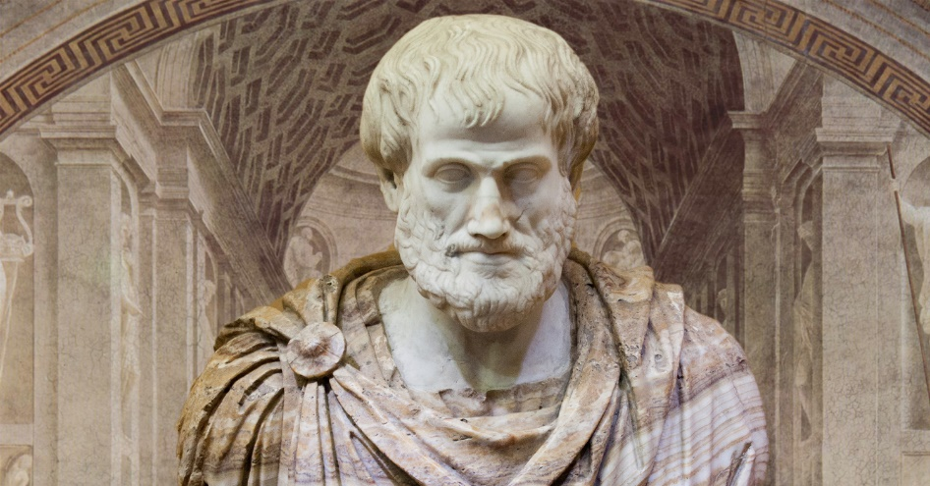

Aristotle
Aristotle is an outstanding scientist and wrote the works on logic, psychology, philosophy, morality, rhetoric, natural sciences. All his works are devoted to studying the ontology. He compiled all his writings on logic in his work called "Organon". Aristotle divides the subjects into two types: theoretical and practical sciences.
Practical sciences are aimed at giving guidance to disciplines, doing something useful. He divided the theoretical sciences into three parts - philosophy (metaphysics), mathematics and physics.
According to his philosophical doctrine, things and phenomena in the universe have four reasons. These are material causes, form or shape cause; creative reason; the purpose reason. The cause of the creator, Aristotle's interpretation, is the source of movement. The motion is eternal as the universe. At the same time, the universe has its eternal cause, that is, the motion force. Aristotle's teaching about society and the state is portrayed in his works such as "The State", "The Politics".

Slide 18
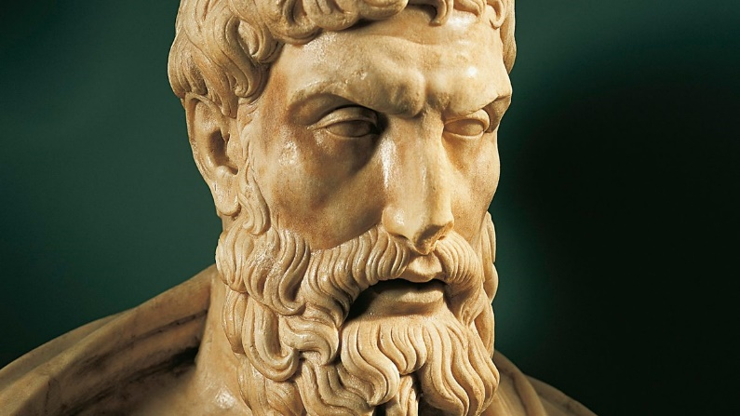
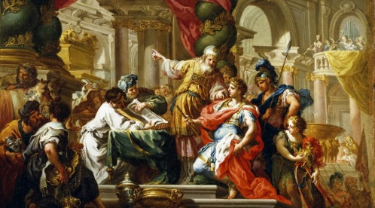
Hellenistic philosophy
Hellenistic philosophy is the one of the periods of Ancient Greek Philosophy that developed in the Hellenistic civilization following Aristotle.
Epicurus (341-270 BC) is an ancient Greek philosopher. He advanced the doctrine of atomism that had been firstly introduced by Democritus. According to Epicurus’s teachings, the universe is material, eternal and infinite atoms. The universe is consisted of the body and emptiness.
The philosophical and moral teachings of Epicurus have been instrumental in that time. In his opinion, the state should be based on the mutual understanding and social agreement of people.

Slide 19
Thank you for your attention!

